Slide 1



salary classification

Slide 2

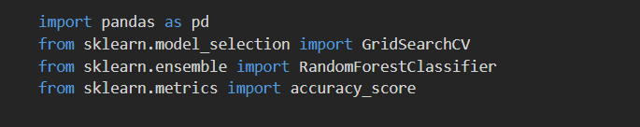
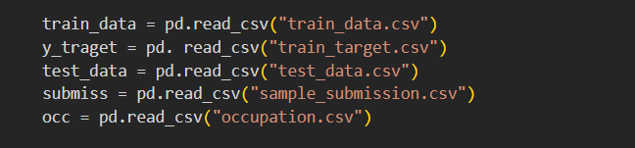
Import libraly
Read CSV file

Slide 3



Data cleaning

Slide 4

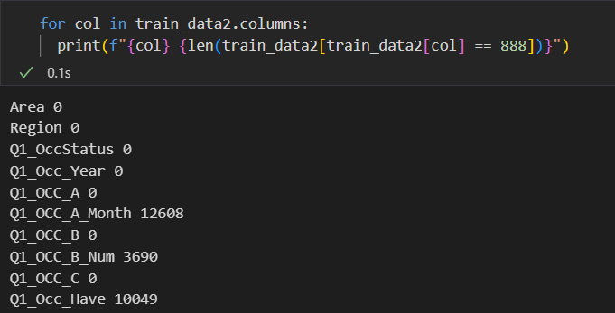

Data cleaning

Slide 5



Data cleaning

Slide 6


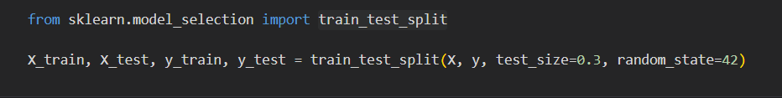
Train test split

Slide 7

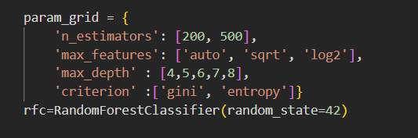

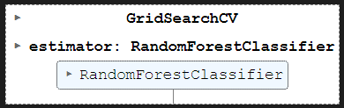
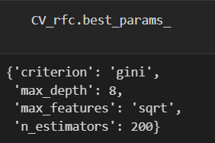
GridSearchCV

Slide 8



RandomForestClassifier model

Slide 9






Prediction and export CSV

Slide 10
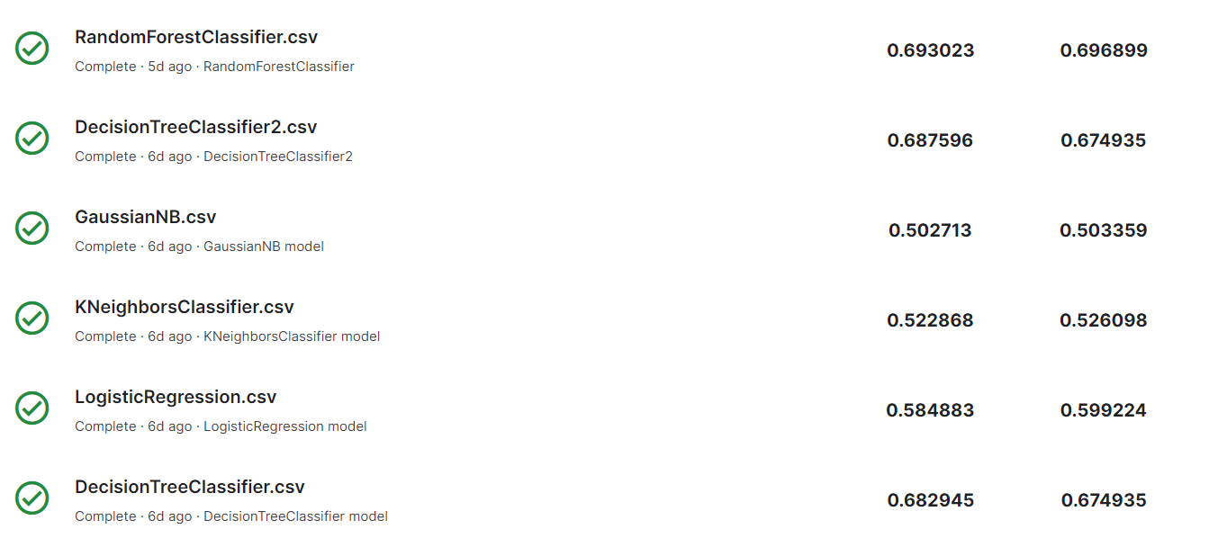
Submission

Slide 11
Thank you

